Slide 1
Fine-mapping Demo dhriti.sengupta@wits.ac.za

Slide 2
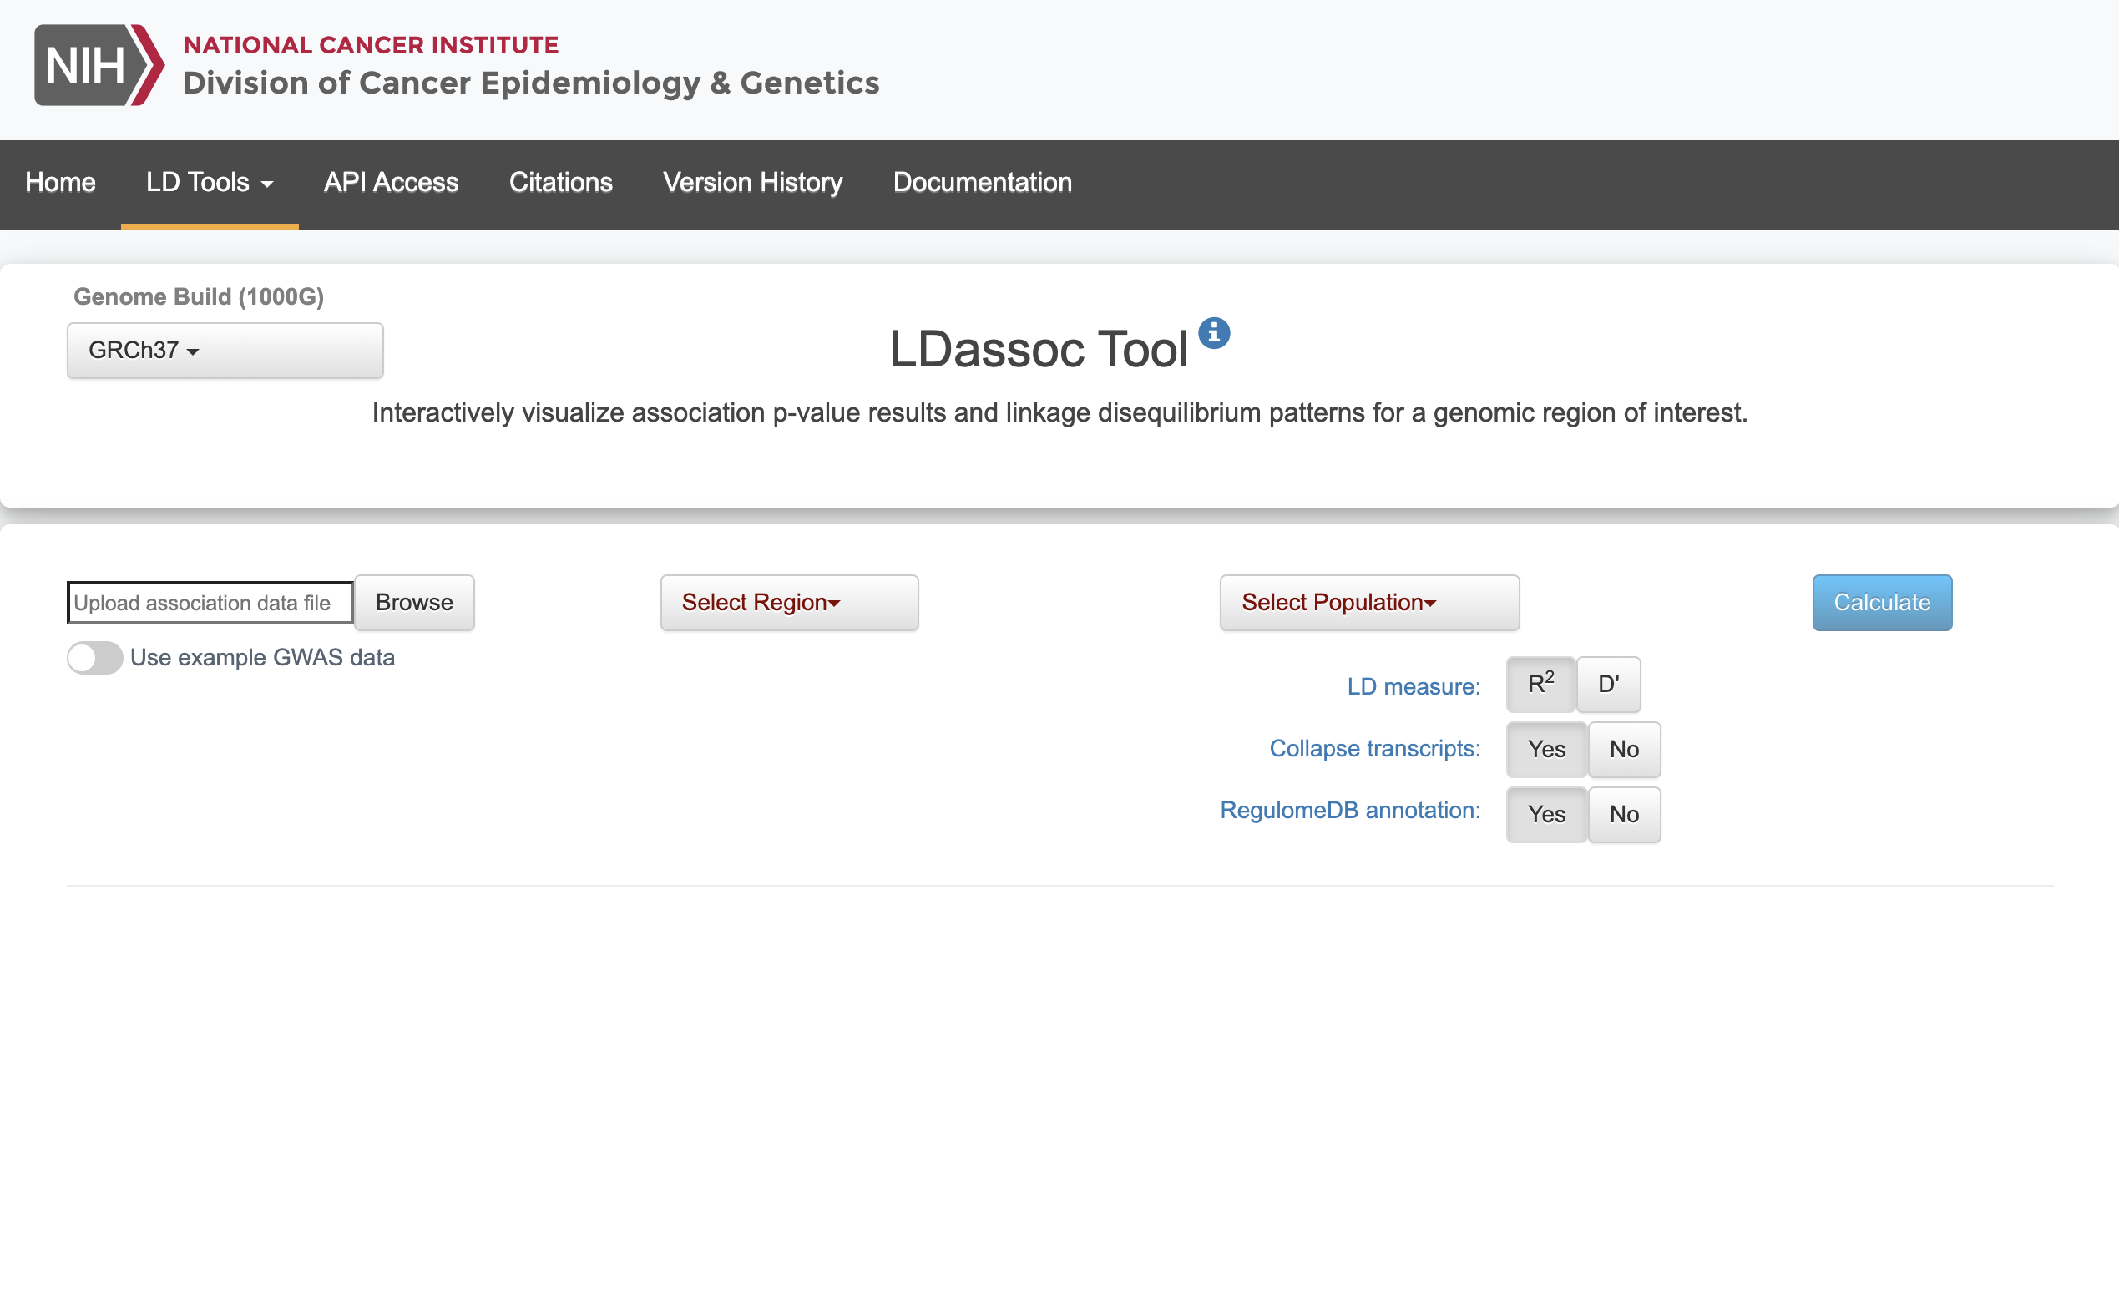
https://ldlink.nci.nih.gov/?tab=ldassoc

Slide 3
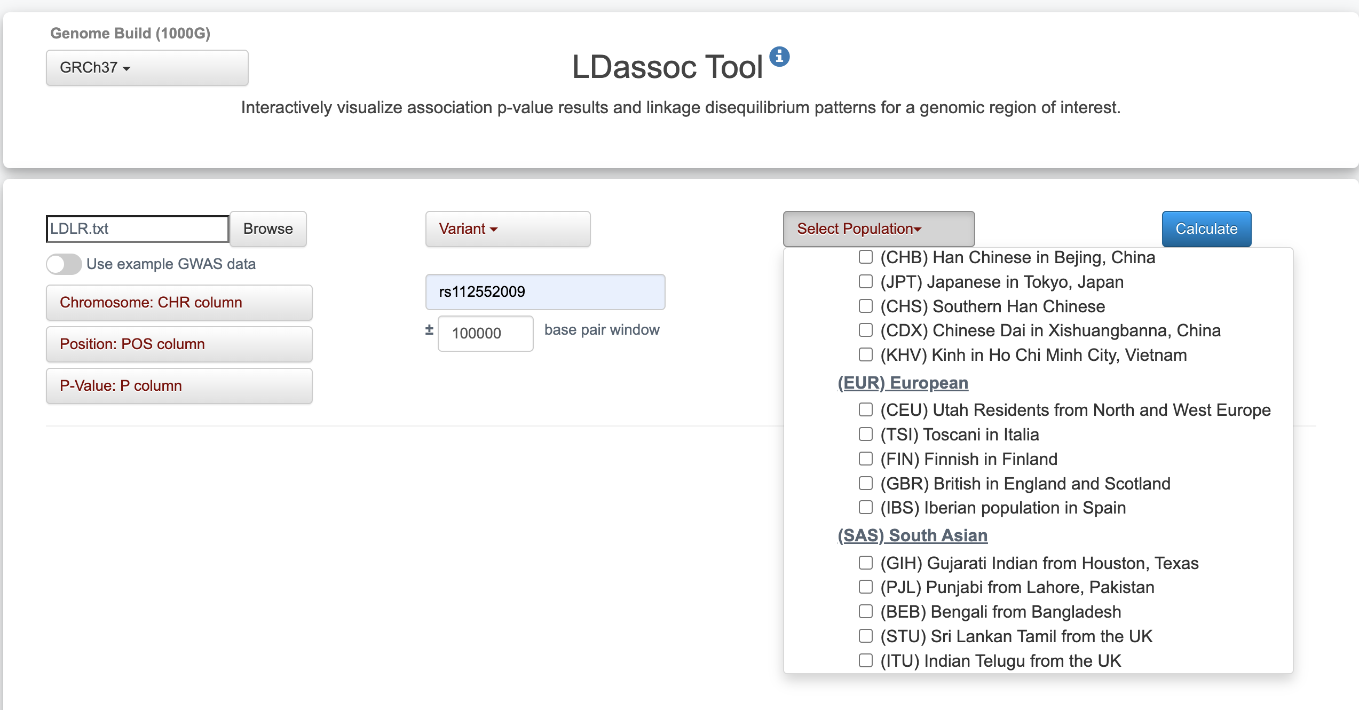
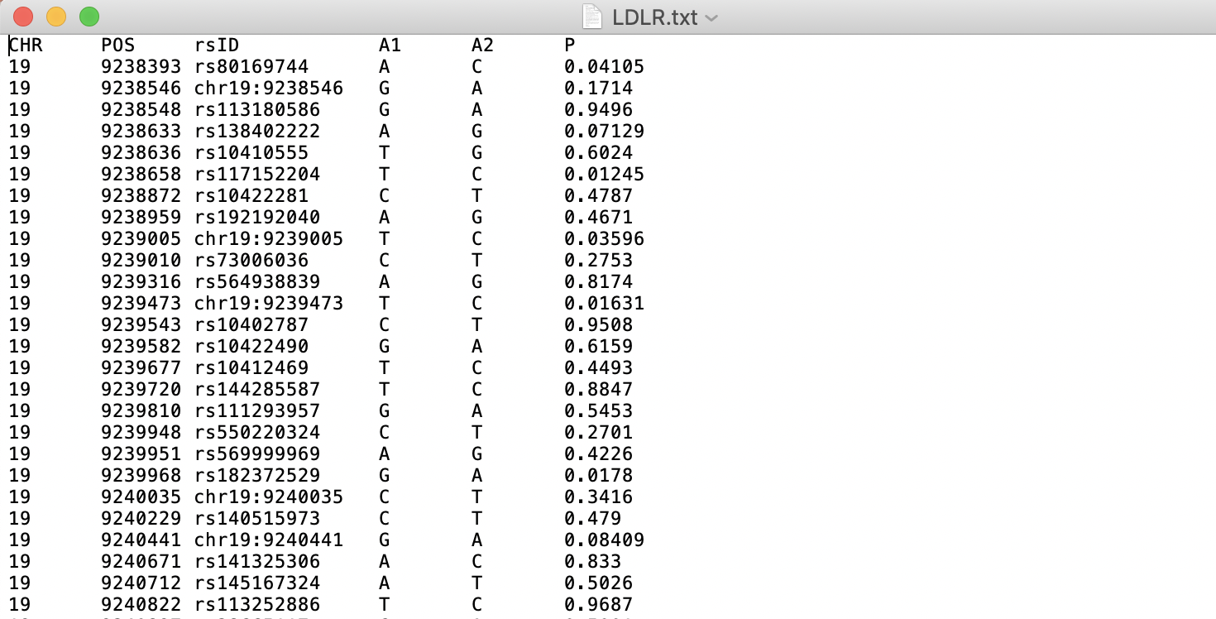

Slide 4
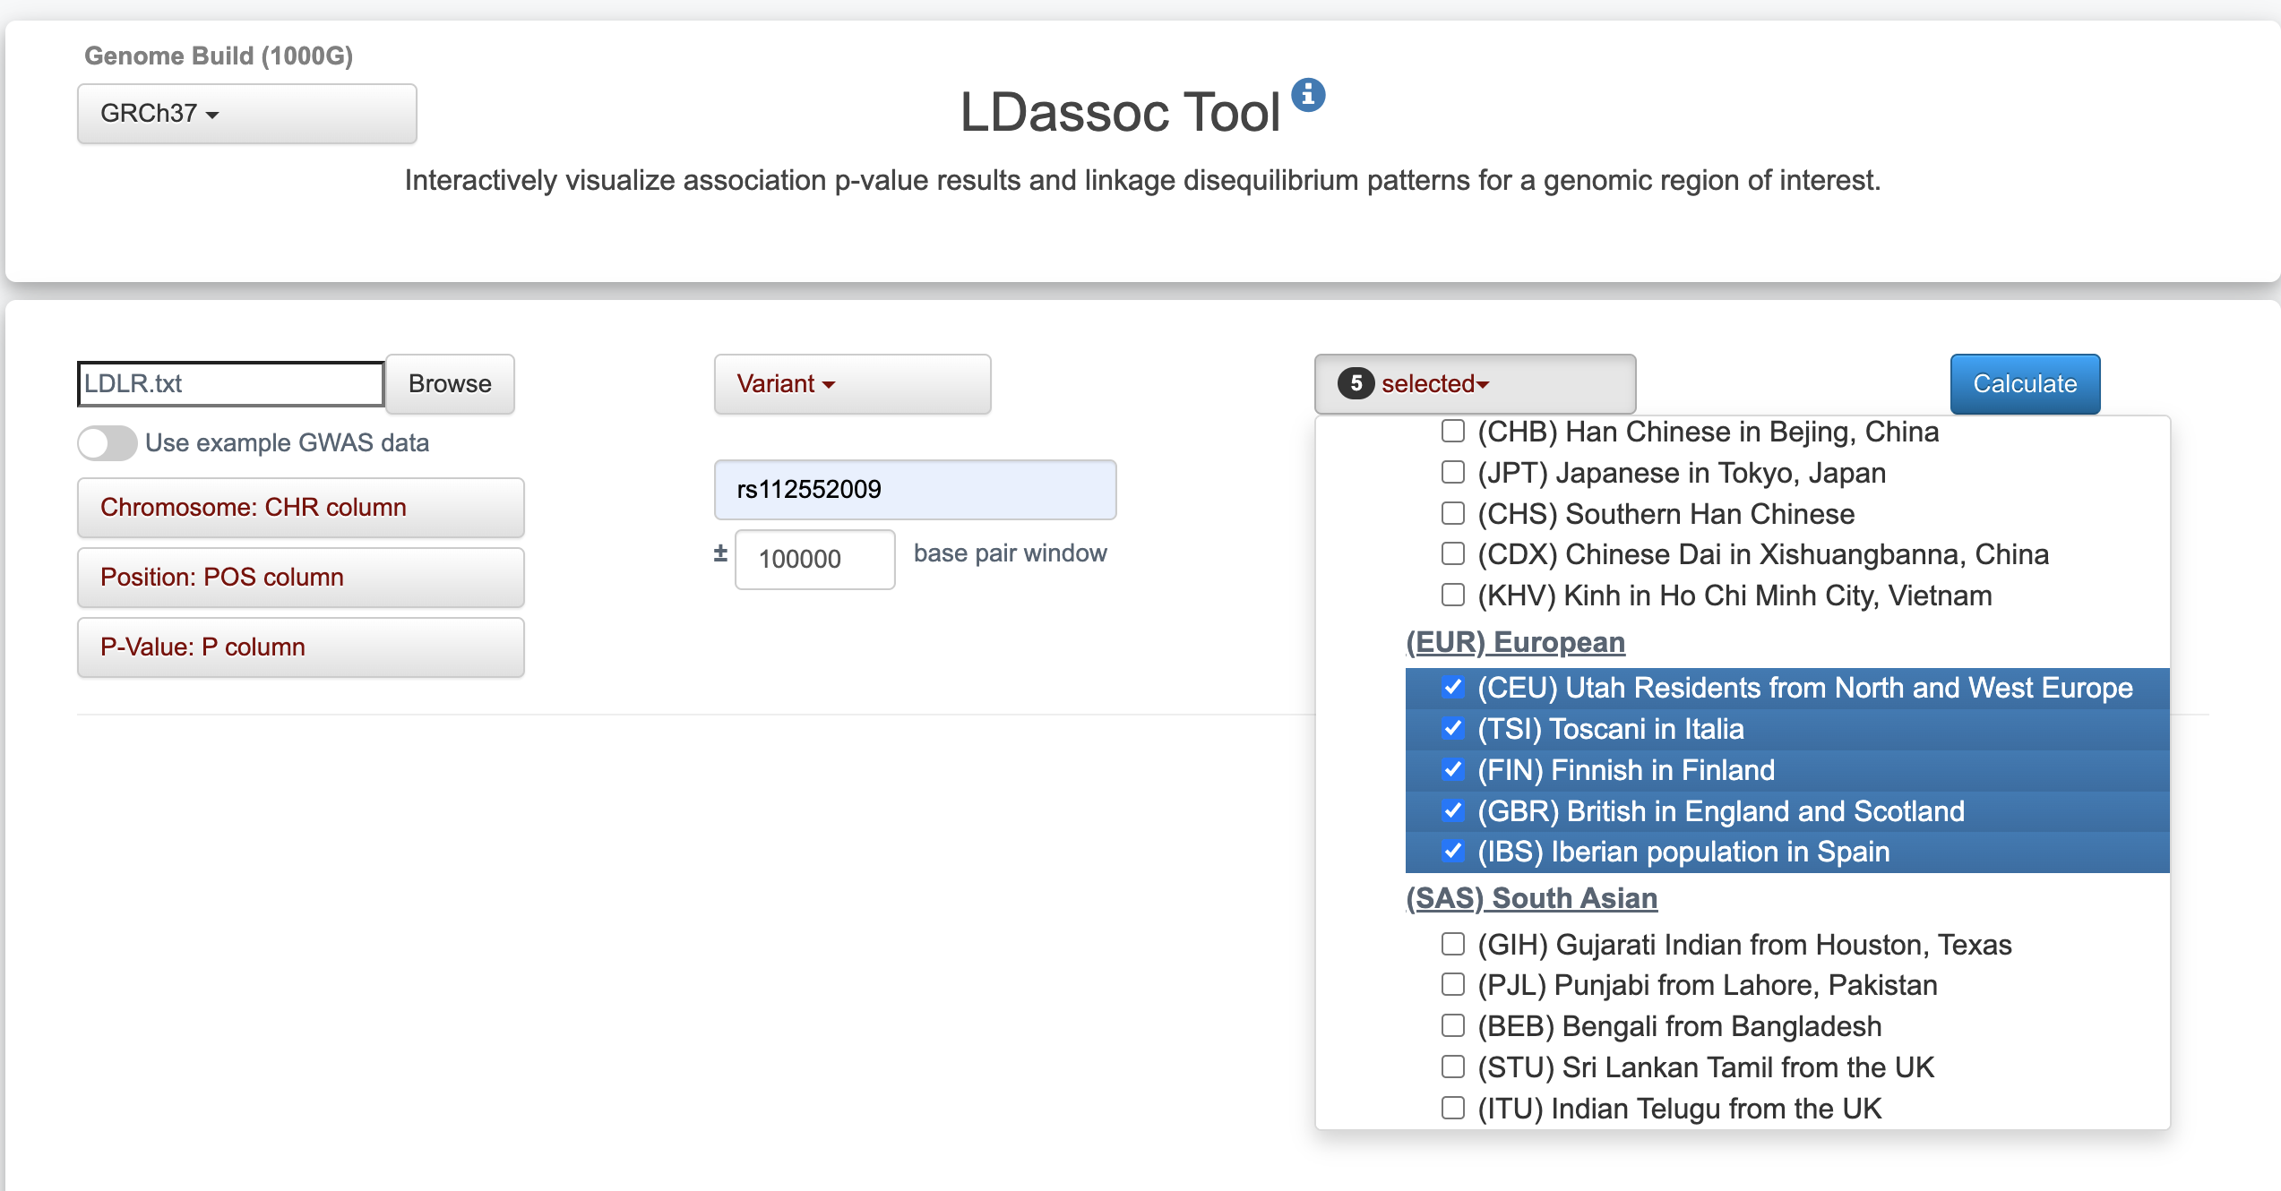

Slide 5
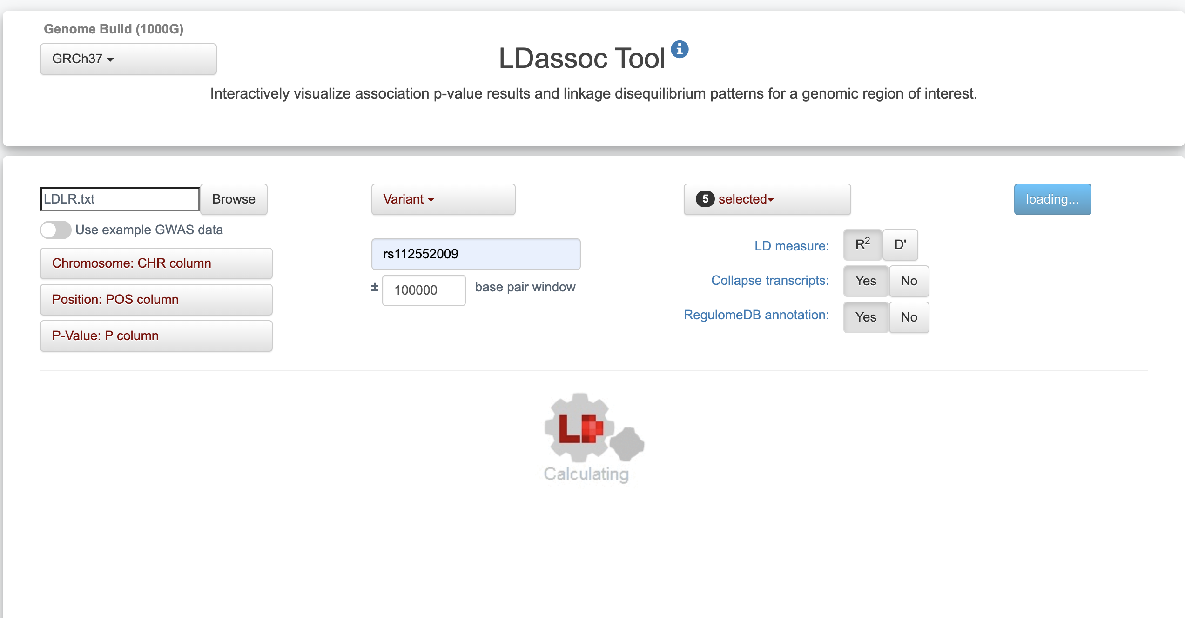

Slide 6
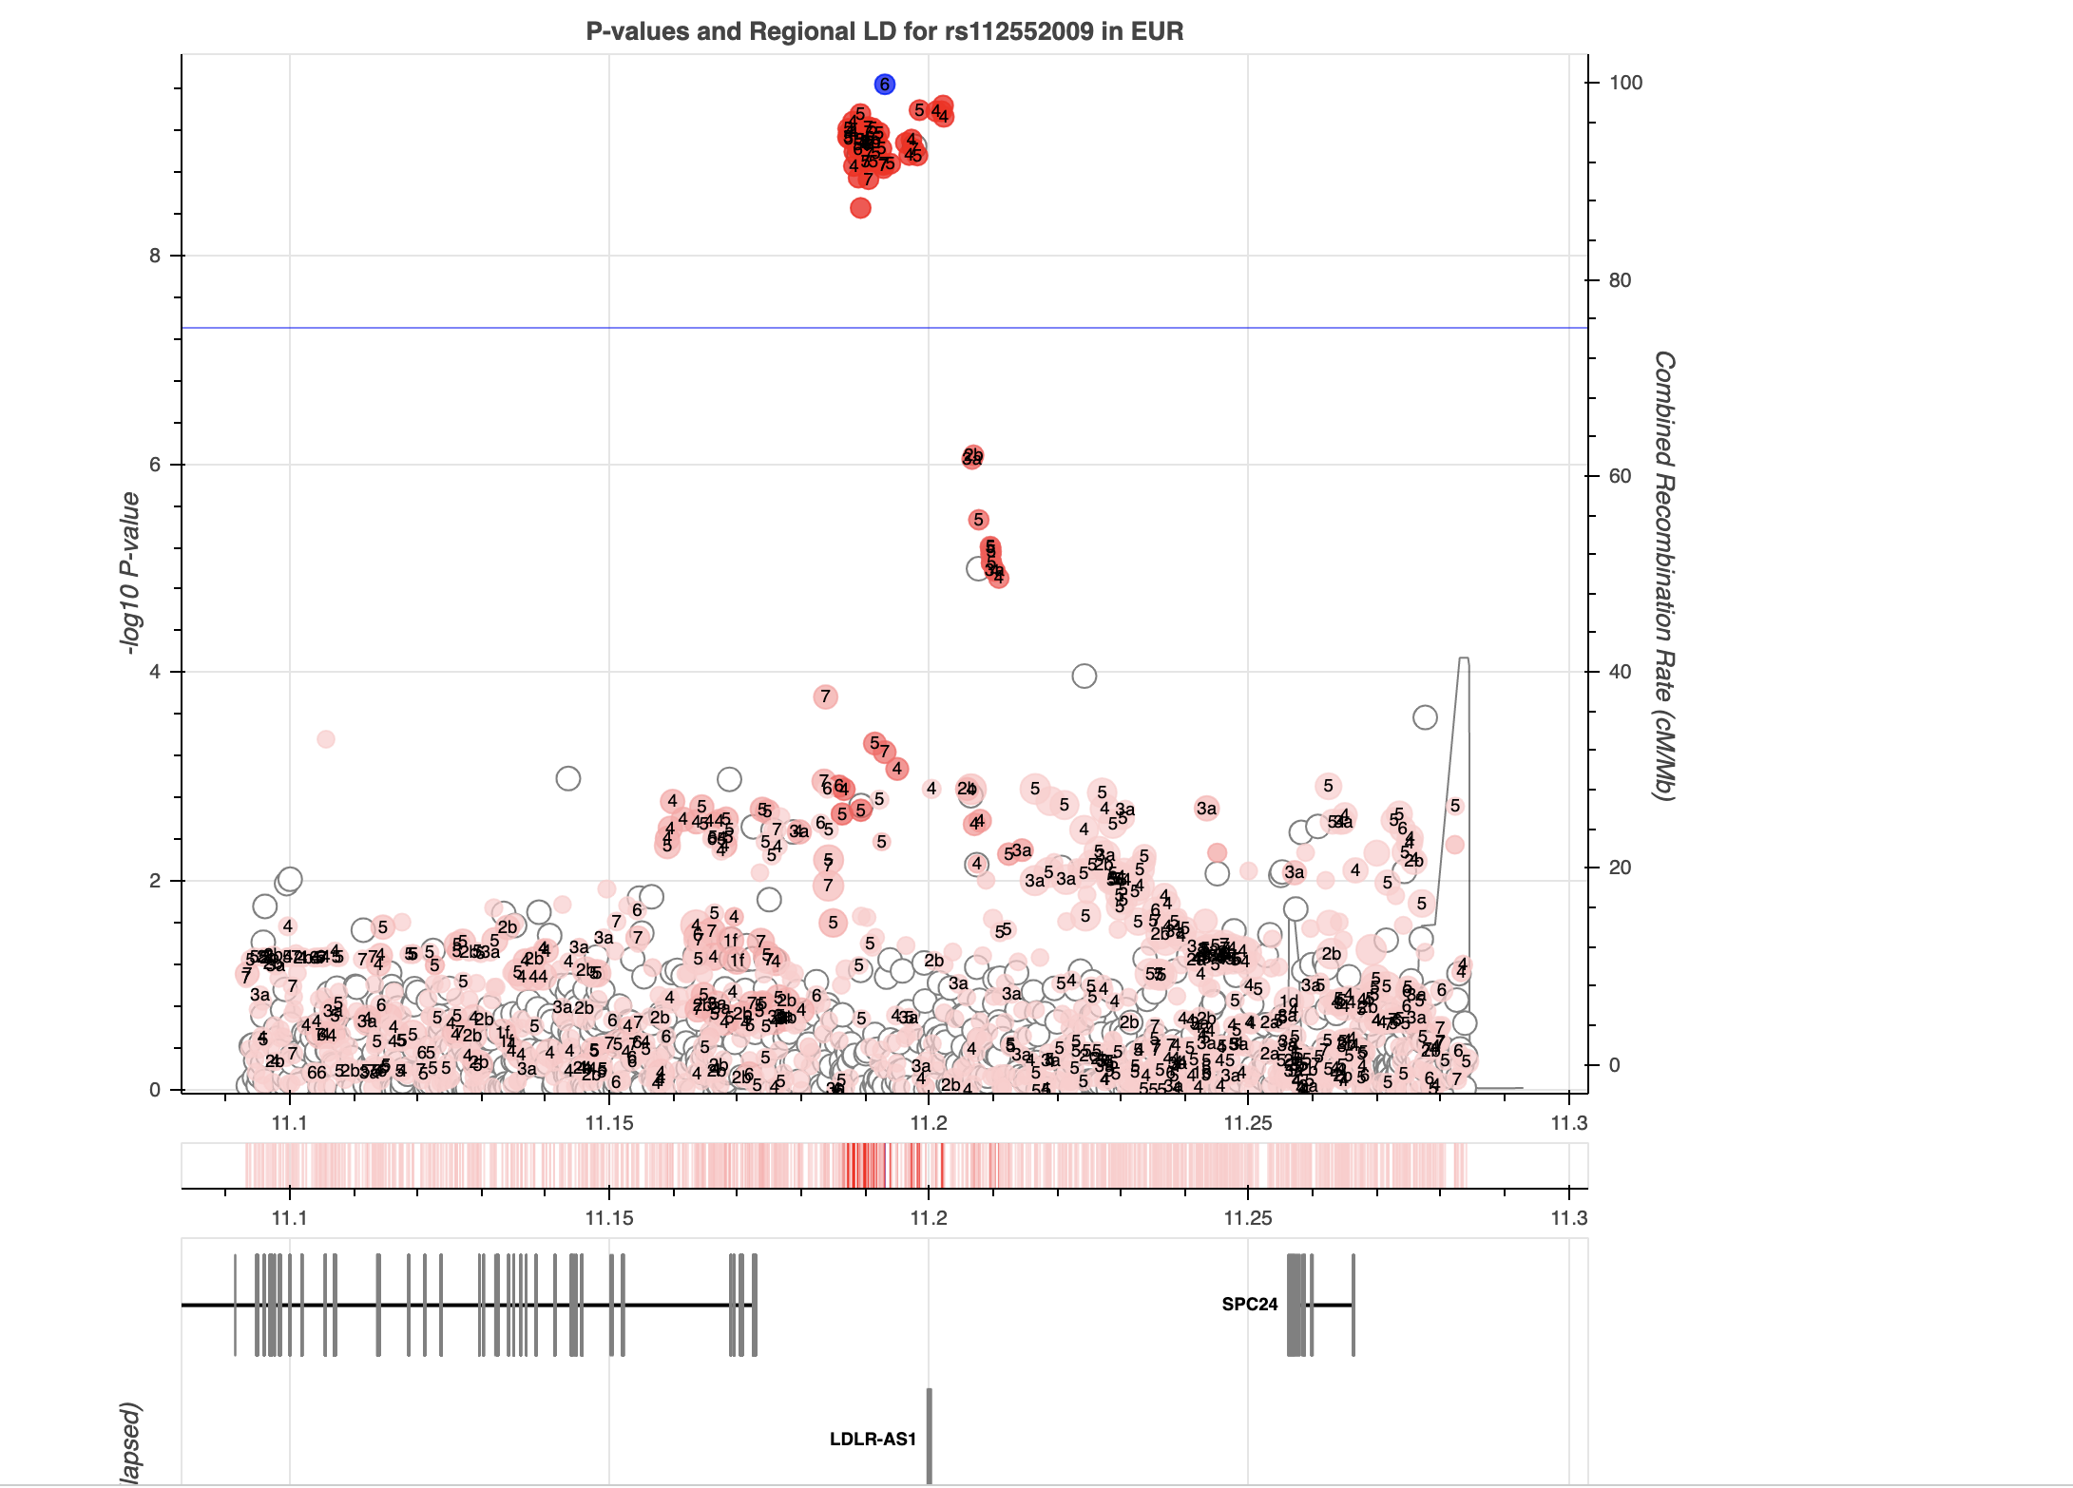
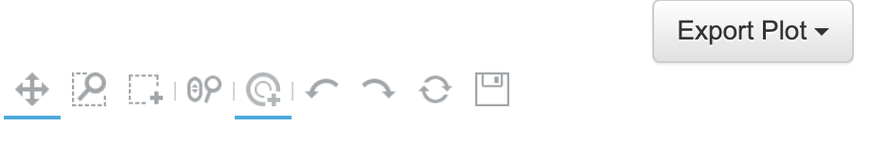

Slide 7
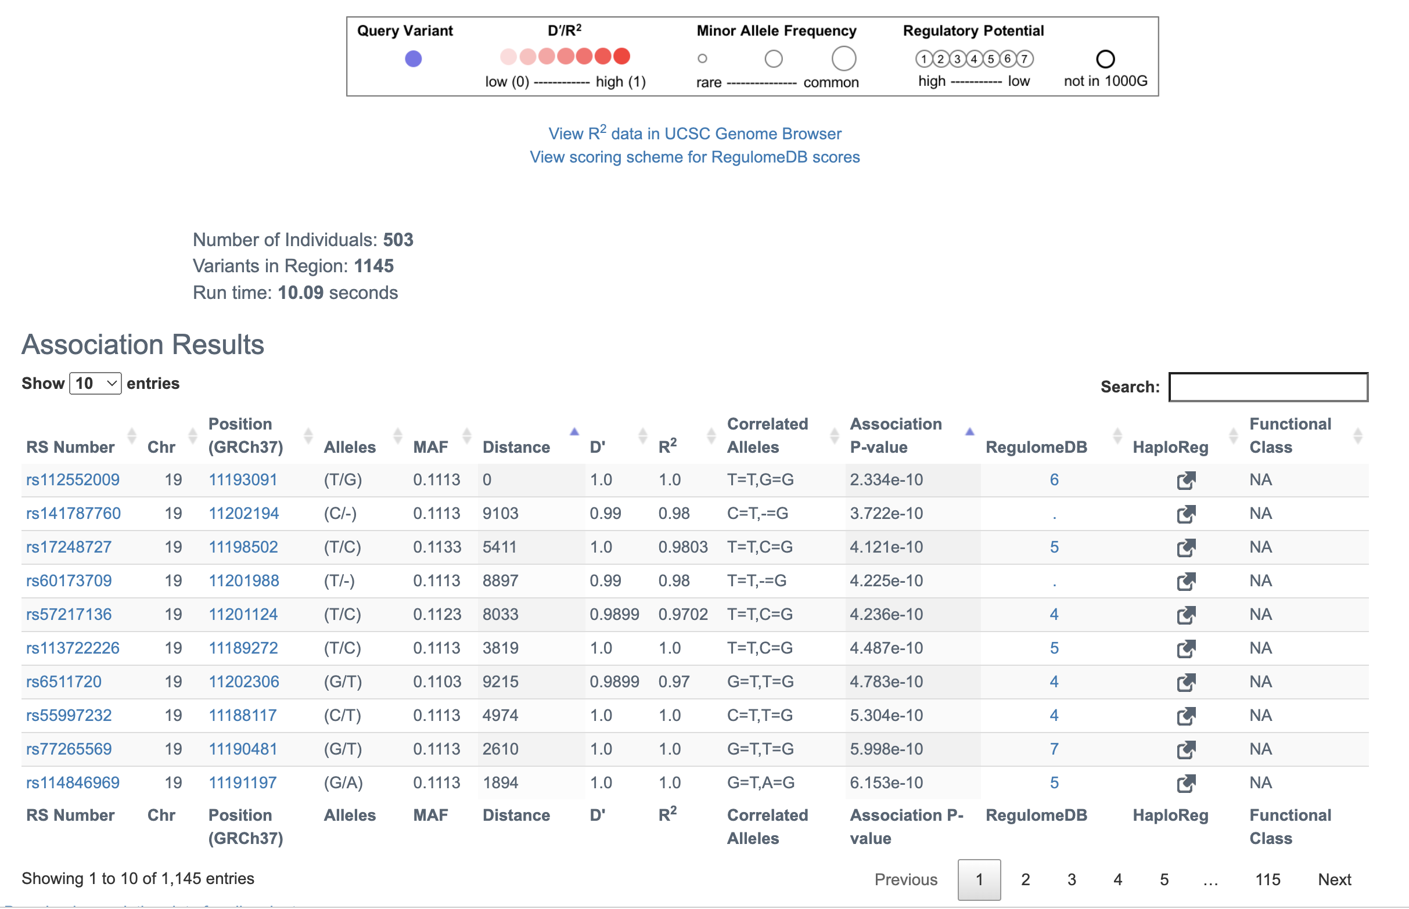

Slide 8
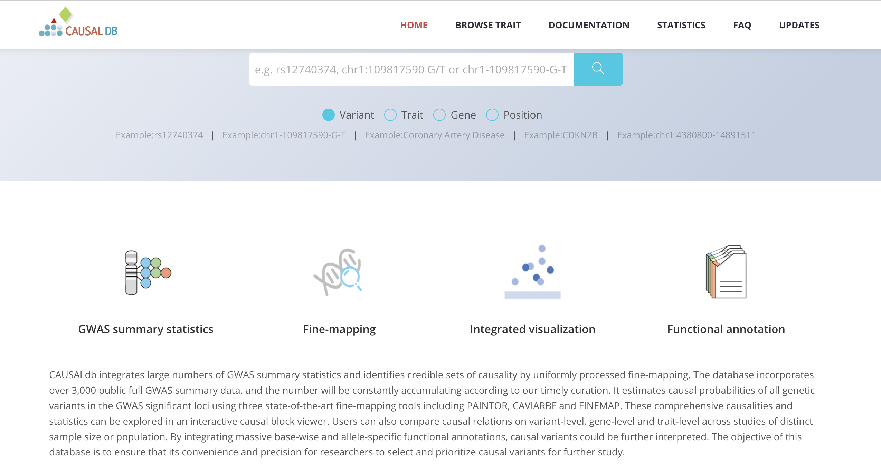
http://www.mulinlab.org/causaldb/index.html

Slide 9
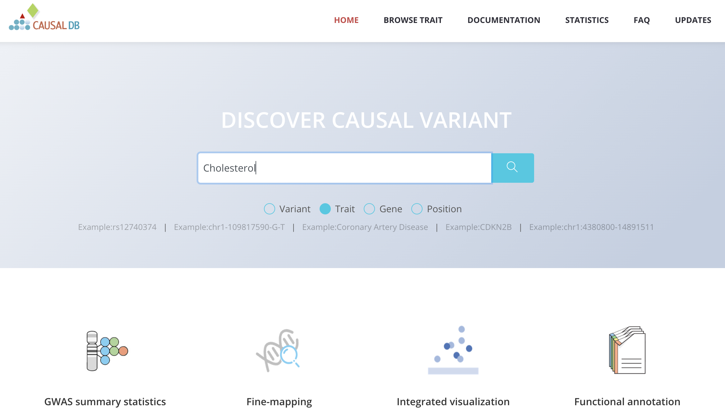

Slide 10
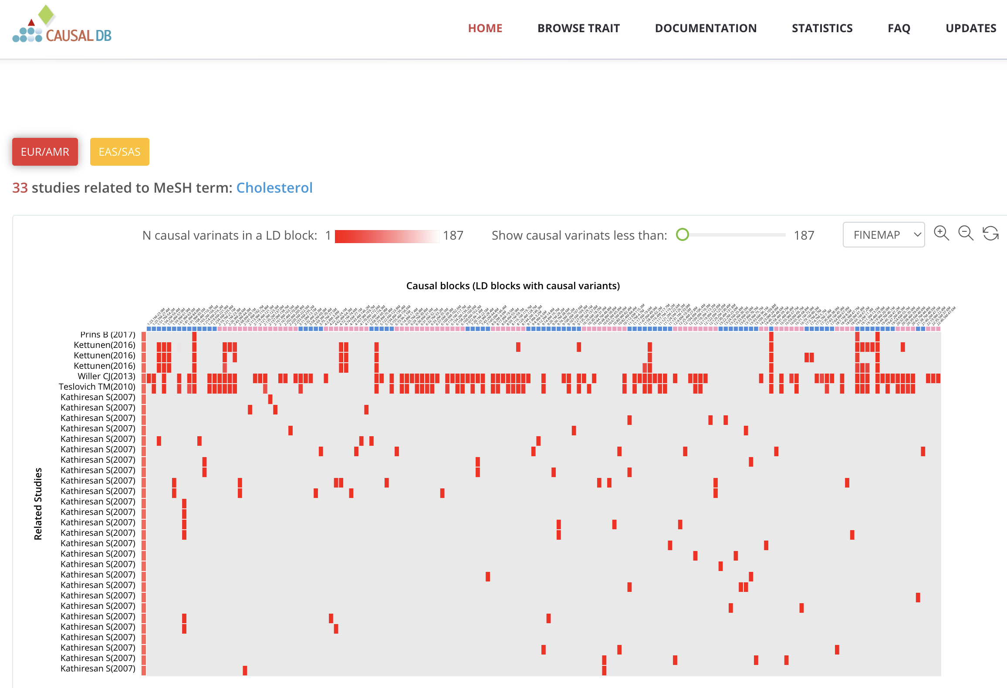
Scroll down

Slide 11
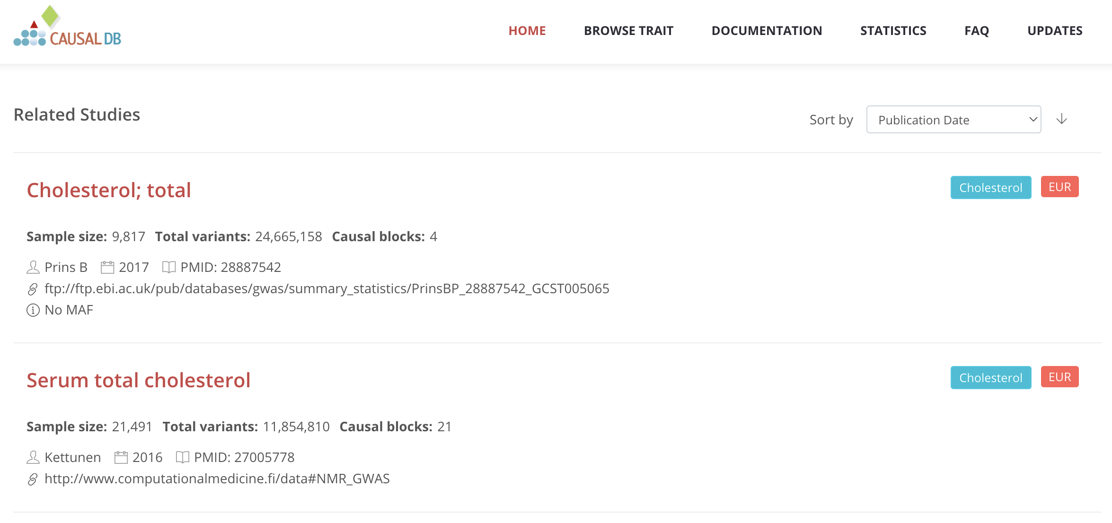

Slide 12
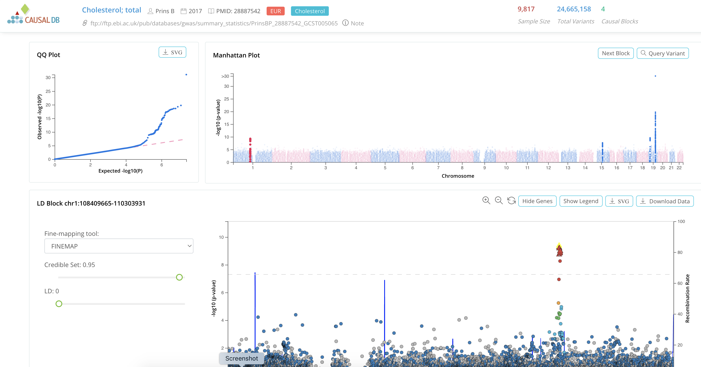

Slide 13
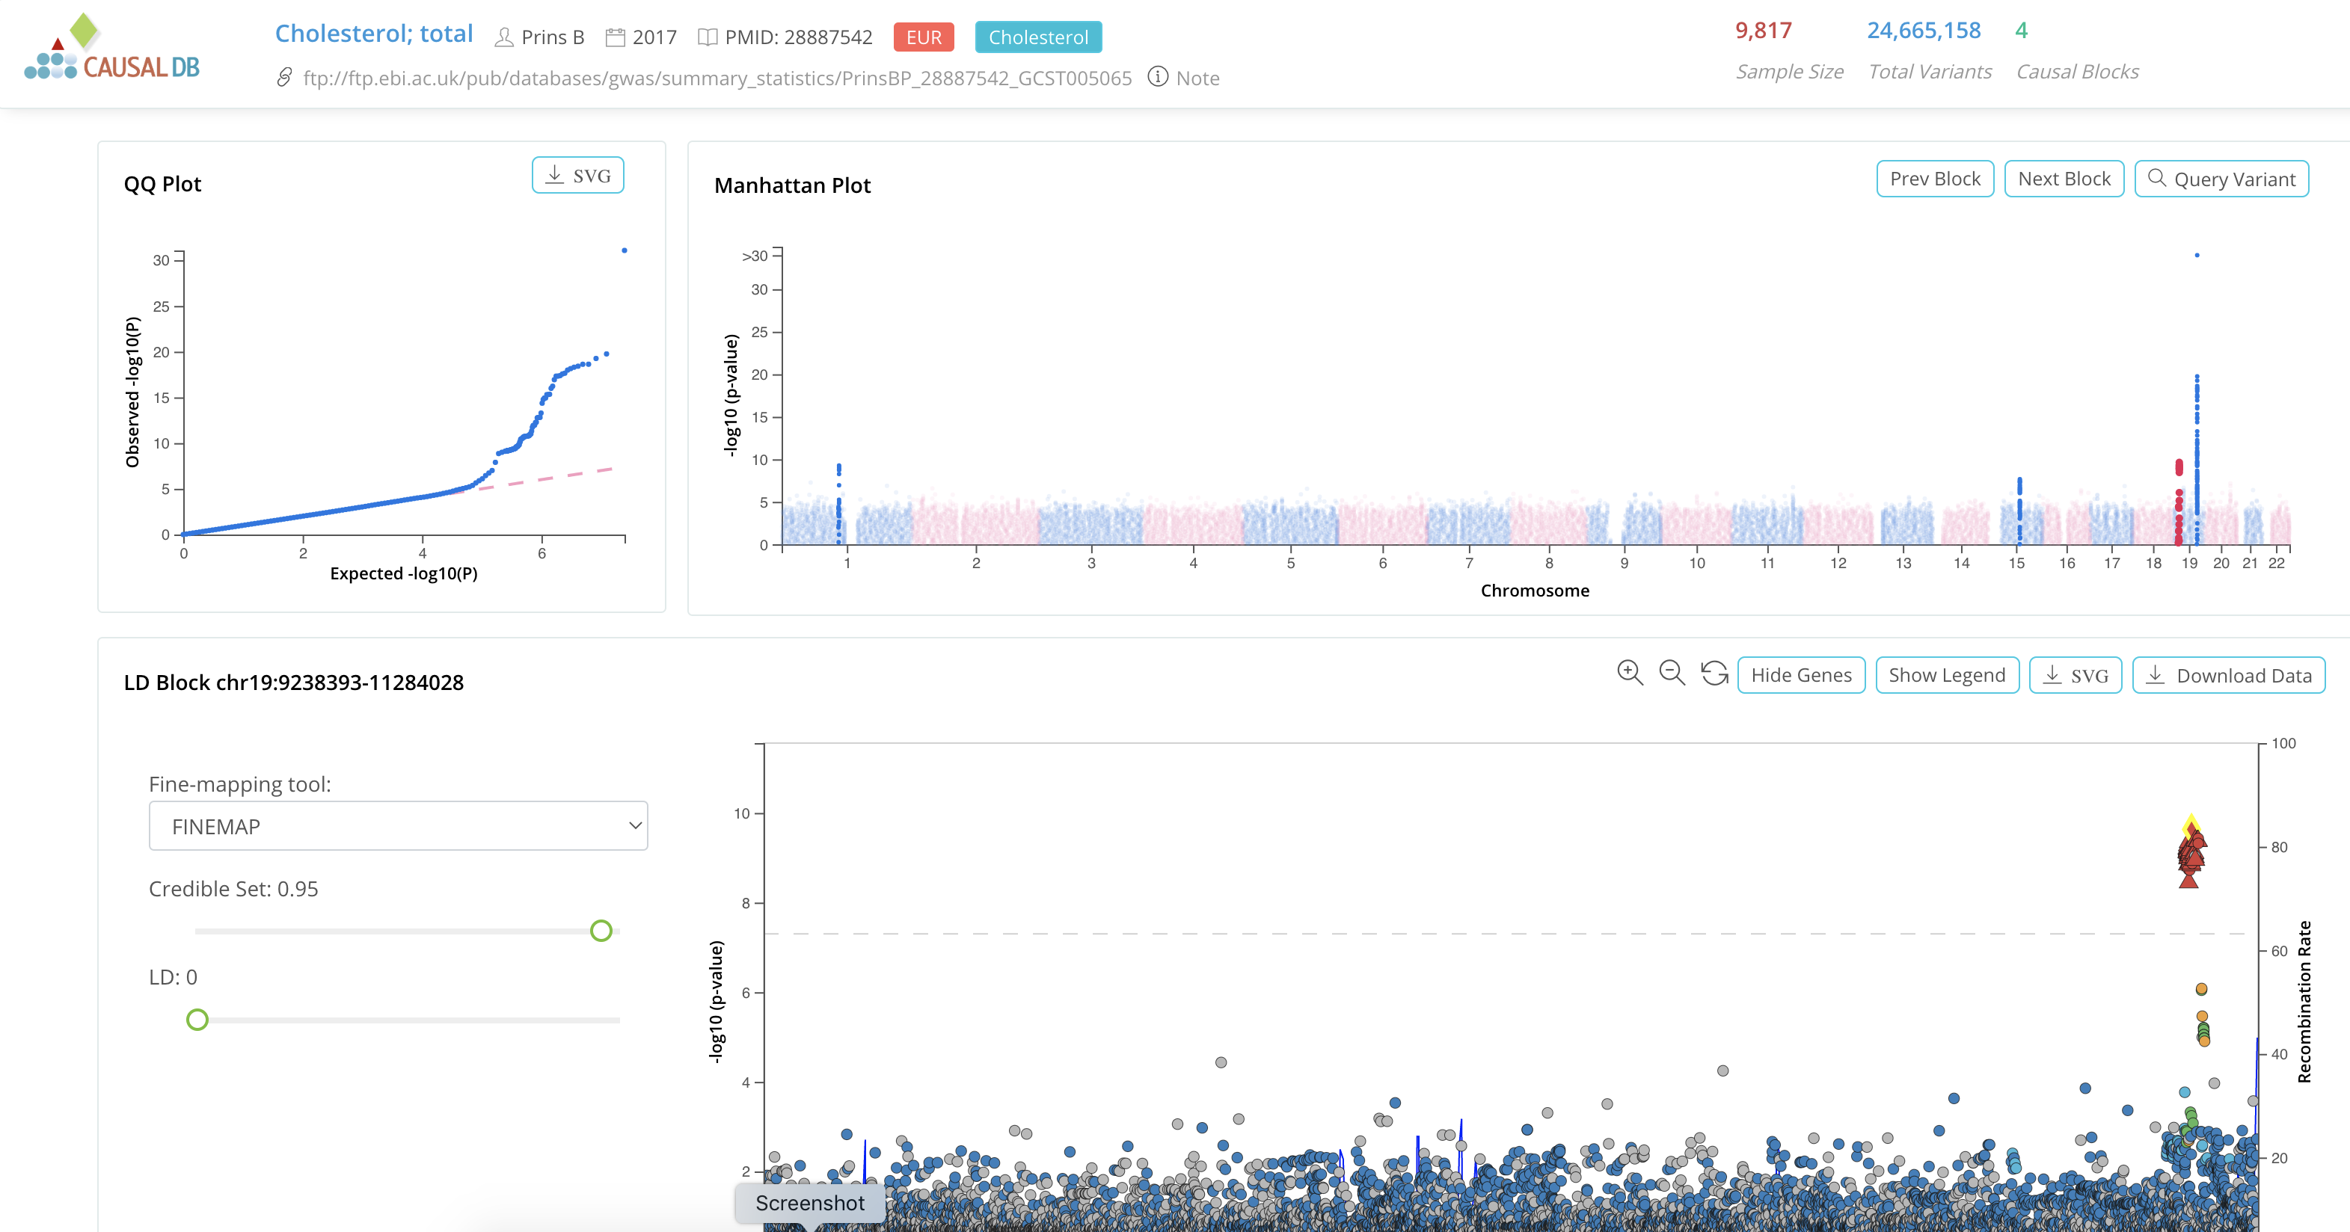
Scroll down

Slide 14
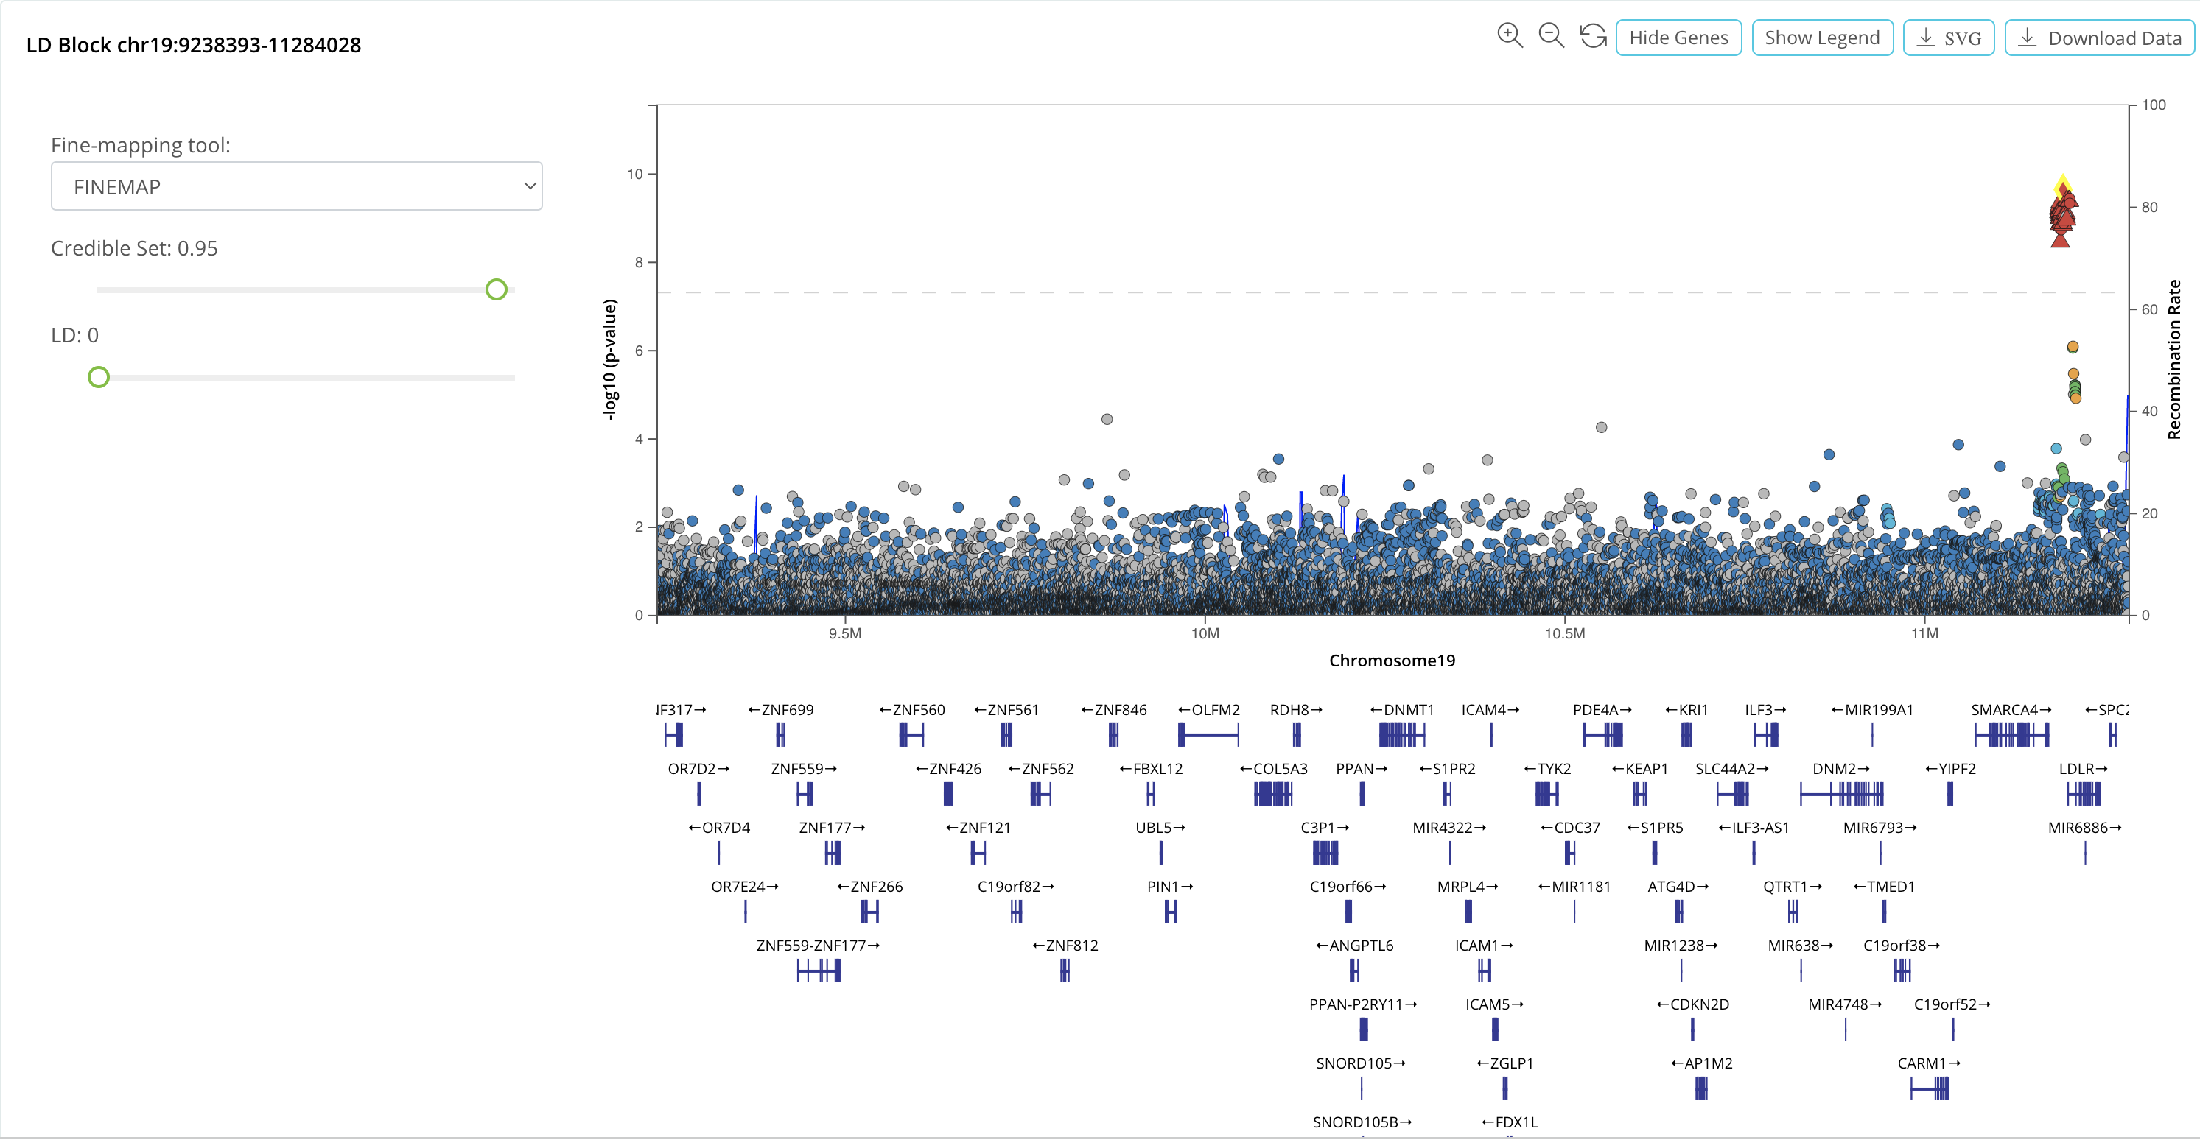
Multiple times

Slide 15
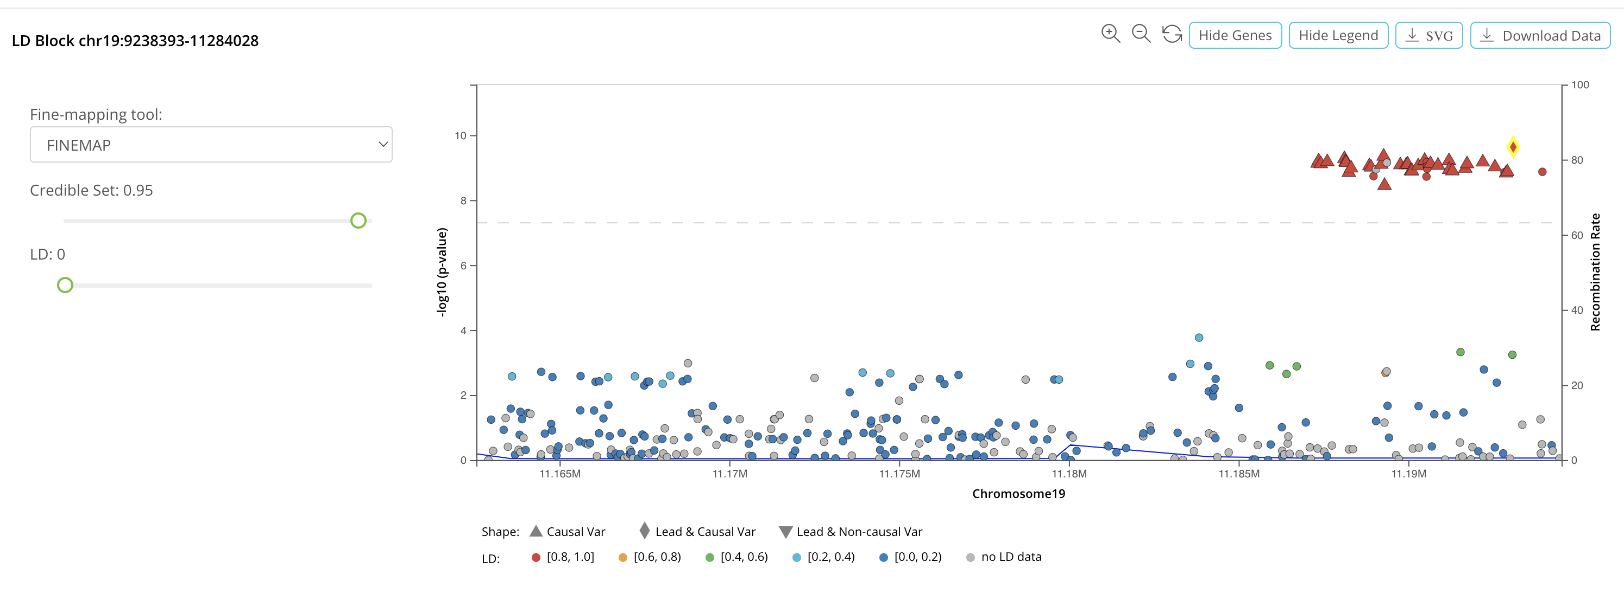
CAVIARBF
PAINTOR
Slide this green circle to set your credible set size
You
Scroll down

Slide 16
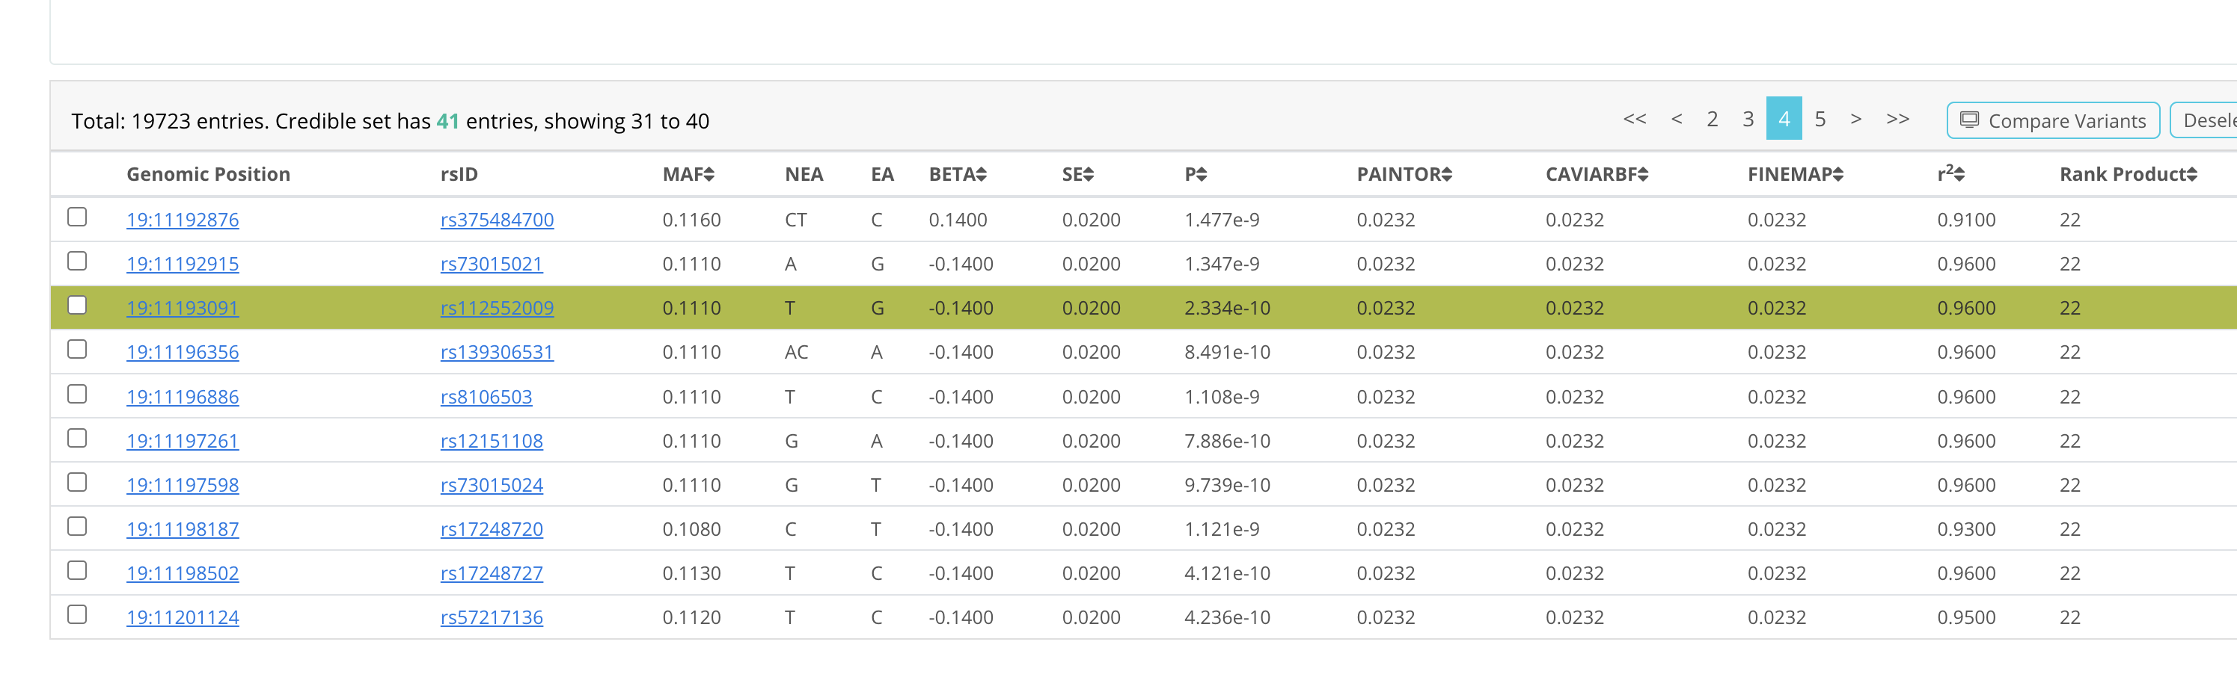
Can sort by any of the columns

Slide 17
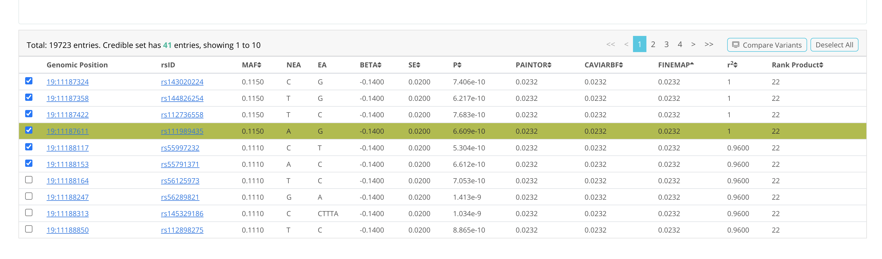
Select the first few SNPs
Compare variants

Slide 18
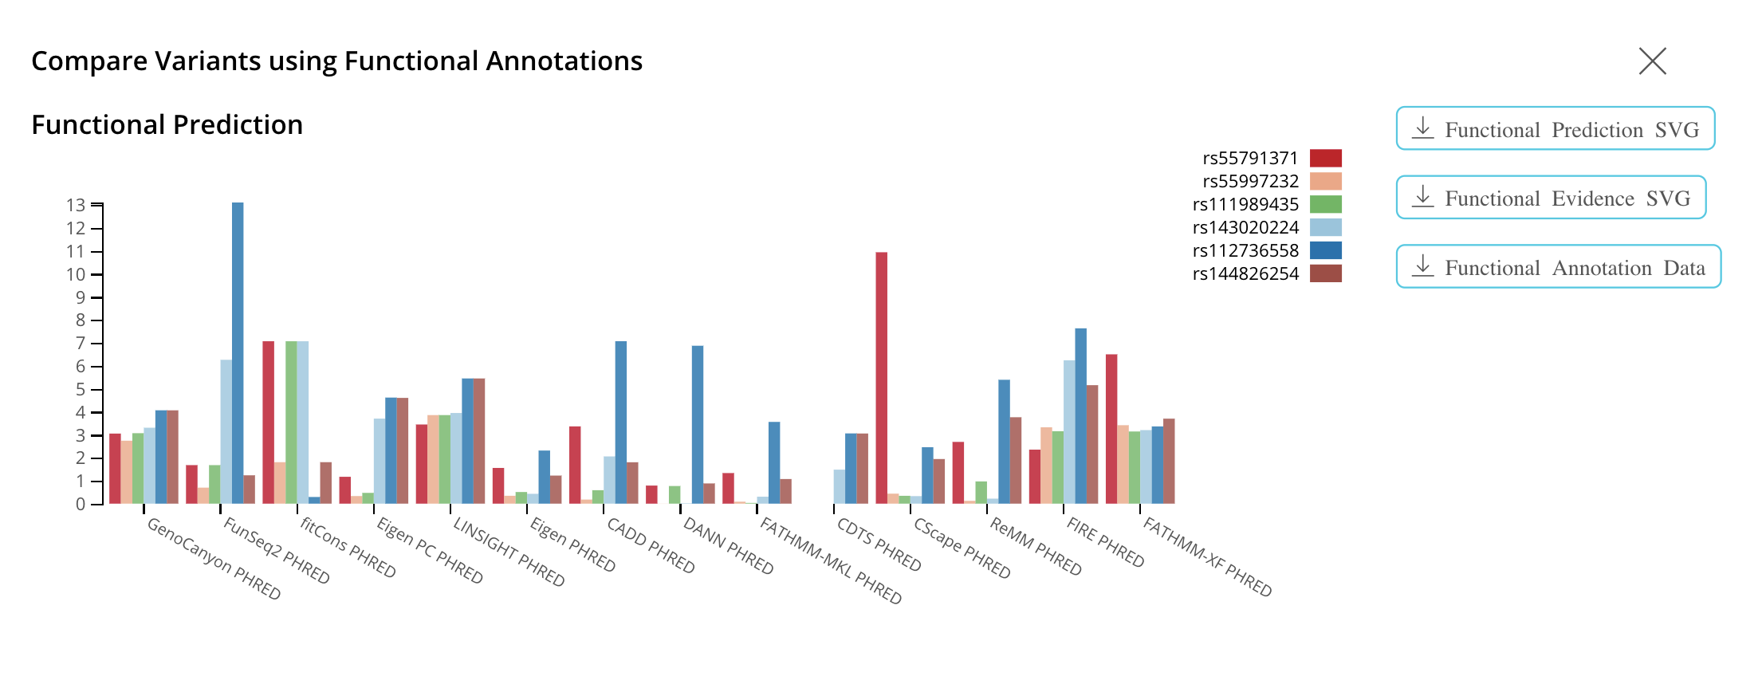
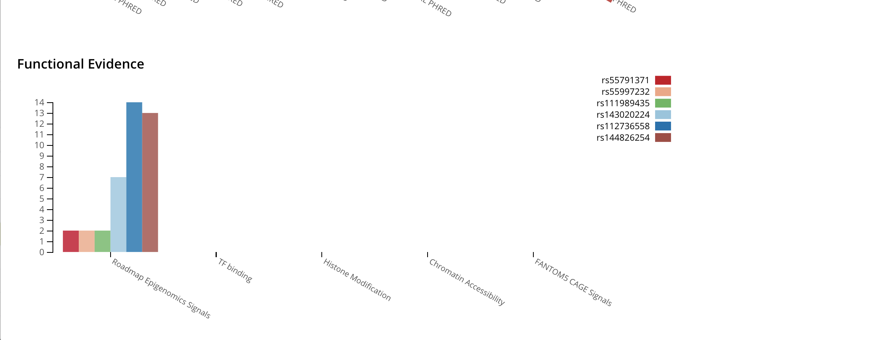
SNP showing highest functional evidence

Slide 19
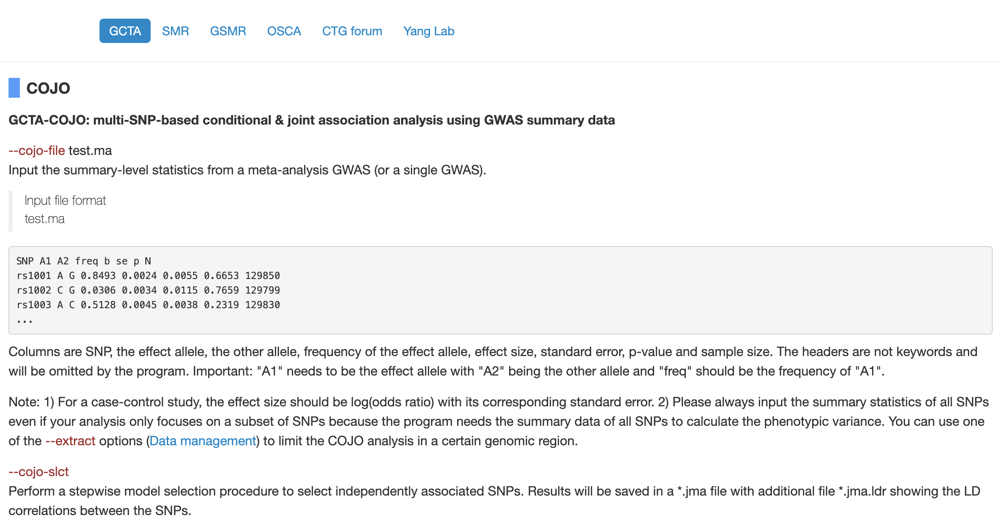

Slide 20
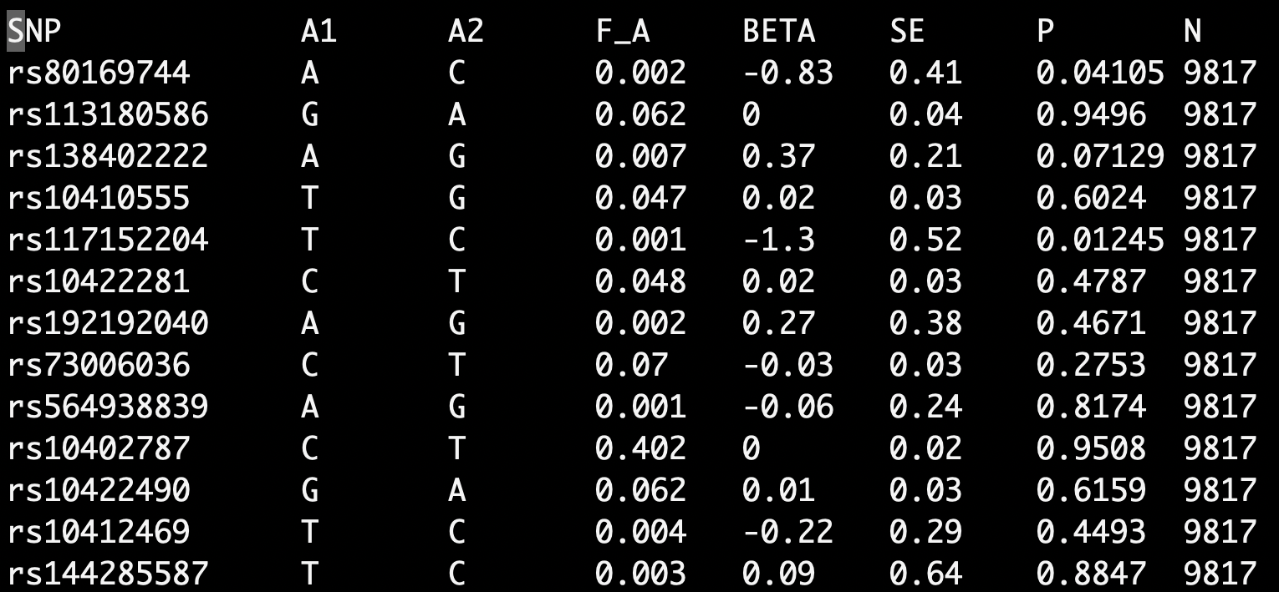
gcta64 --bfile san.chr19 --cojo-file ldlr.ma --cojo-slct --out san.chr19

Slide 21
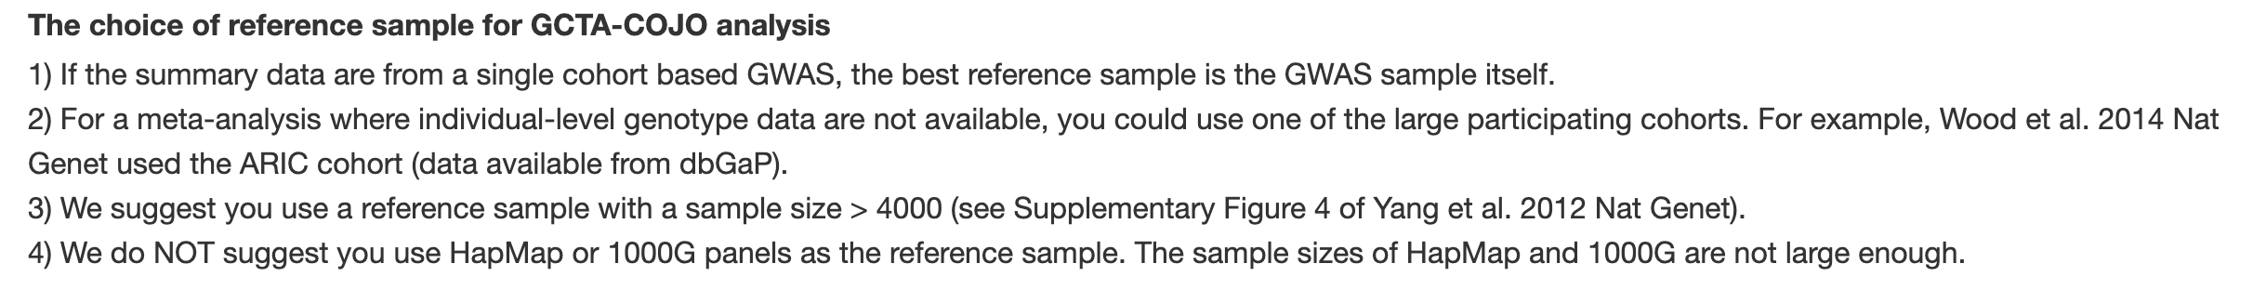
COJO file (san.chr19.jma.cojo) description
chromosome
physical position
frequency of the effect allele in the original data
frequency of the effect allele in the reference sample
effect size, standard error and p-value from the original GWAS or meta-analysis
effect size, standard error and p-value from a joint analysis of all the selected SNPs
SNP
effect allele

